Slide 1
Your guide to
RUN InnoBoost
https://innoboost.eu

Slide 2

INTRODUCTION
TUS Pathways to Entrepreneurship
2

Slide 3

Our Focus Today
Why Entrepreneurship for Students?
Entrepreneurship = mindset, not just startups
21st-century skills: adaptability, creativity, resilience
Students must learn to innovate – experience where possible, not only memorize

Slide 4
Why Focus on Innovation Competencies?
Nurturing and assessing innovation competencies — skills & mindsets to create, adapt, and lead change.
Not just teaching innovation, but embedding it as a way of learning.
Entrepreneurship at TUS is evolving — projects like RISE (HEA-funded) and InnoBoost (EIT-funded) strengthen innovation and research capacity across the university.

Slide 5

What Does Innovation Mean to You?
When you think of innovation — what skills or behaviours come to mind that students need to practice?”

Slide 6
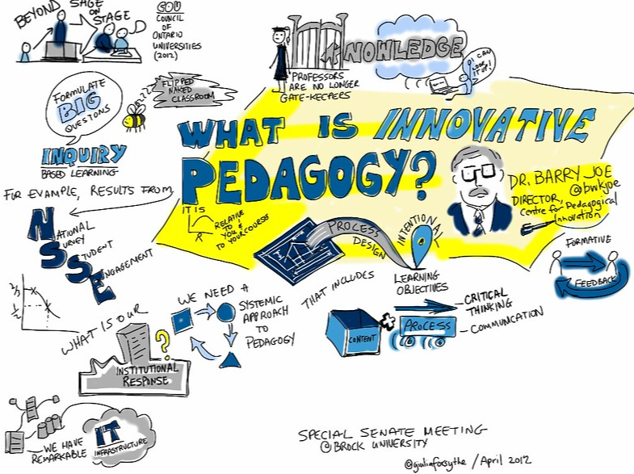
What is Innovation Pedagogy?
Learner-centered, real-world problem solving
Combines creativity, collaboration, experimentation
Moves beyond theory → experience

Slide 7


Case Study: NASA Space Apps Challenge - Innovation Pedagogy in Action
200+ participants across disciplines
48 hours of collaboration and creativity
Challenge: Shannon River Basin
Winning Team: Project Cea-SAR – forecasting floodplain dynamics

Slide 8
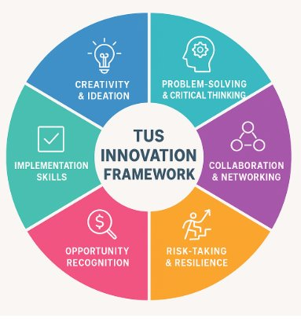
Innovation Competencies Defined
Innovation Competencies Defined
Creativity & Ideation
Problem-Solving & Critical Thinking
Collaboration & Networking
Risk-Taking & Resilience
Opportunity Recognition
Implementation Skills

Slide 9

Pathways to Entrepreneurship
Exploration → Experimentation → Execution
Builds innovation competencies step by step
Each stage = learning → practice → reflection

Slide 10
Assessing Innovation Competencies
Assess process + mindset, not just outcomes
Use feedback, not only grades
Emphasise reflection, collaboration, problem-solving

Slide 11
Follow our Journey
https://innoboost.eu

